Slide 1
SECURE DATA HIDING IN IMAGES USING STEGANOGRAPHY
CAPSTONE PROJECT
Presented By: Tushar Kushwaha
Student Name : Tushar Kushwaha
College Name & Department : College of computing science and information technology

Slide 2
OUTLINE
Problem Statement
Technology used
Wow factor
End users
Result
Conclusion
Git-hub Link
Future scope

Slide 3
Problem Statement
In today's digital age, the need for secure communication is paramount. Traditional encryption techniques can sometimes attract unwanted attention, making it necessary to explore more covert methods. This project aims to implement a steganographic system to hide sensitive data within digital images. The goal is to develop a method that embeds and extracts data seamlessly while ensuring minimal distortion of the host image and robust security measures against unauthorized access.

Slide 4
Technology used
Image Processing Libraries: OpenCV,
Steganography Techniques: Least Significant Bit (LSB), Discrete Cosine Transform (DCT)
Cryptography Libraries: PyCryptodome, OpenSSL
Programming Languages: Python
Integrated Development Environment (IDE): IDLE(PYTHON)

Slide 5
Wow factors
Seamless Integration: The ability to embed data within digital images without noticeable distortion showcases advanced image processing techniques.
Enhanced Security: Combining steganography with cryptographic methods ensures robust security, making it difficult for unauthorized entities to detect or extract the hidden data.
Real-World Applications: The project has practical applications in fields like secure communication, digital watermarking, and data protection, making it highly relevant in today's digital age.
User-Friendly Interface: Designing an intuitive interface for embedding and extracting data enhances user experience and accessibility.

Slide 6
End users
Government Agencies: For secure communication and protection of sensitive information.
Businesses and Corporations: To safeguard intellectual property, confidential data, and trade secrets.
Journalists and Whistleblowers: For covertly transmitting information while protecting sources and themselves.
Cybersecurity Firms: As part of their suite of data protection and secure communication tools.
Digital Artists and Photographers: For digital watermarking and protecting their work from unauthorized use.

Slide 7
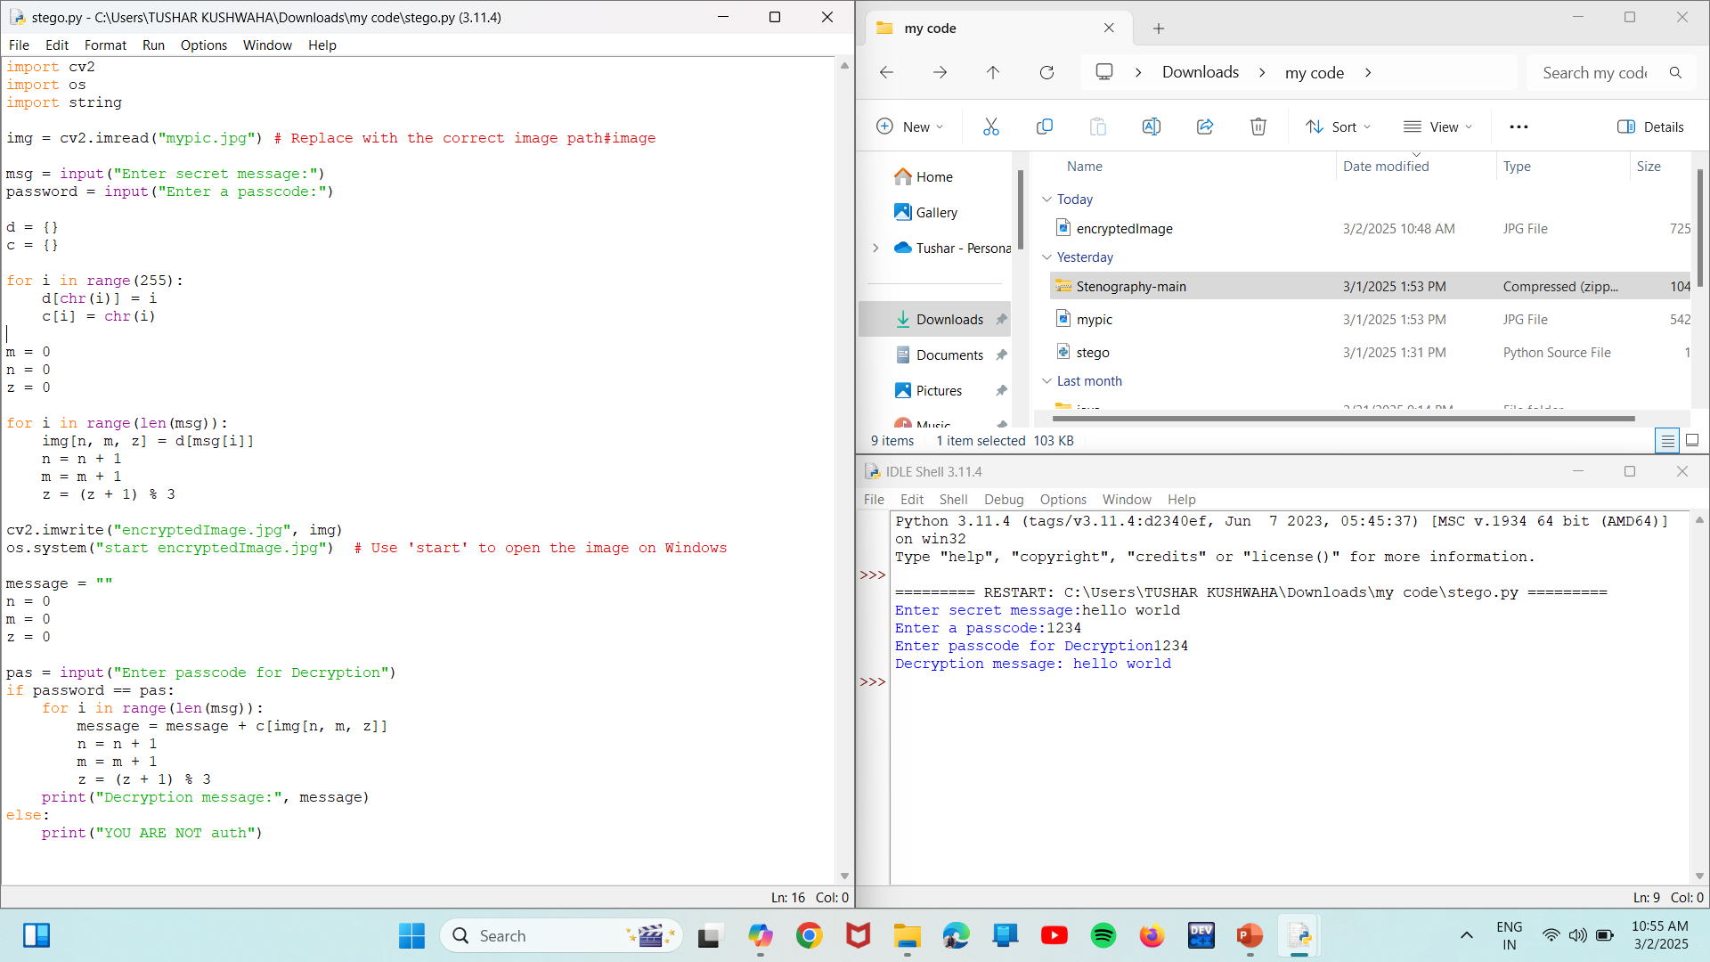
Results
Screenshots of the outcome (min 3)

Slide 8
Conclusion
In conclusion, the project successfully demonstrates the application of steganography to secure sensitive information within digital images. By leveraging advanced steganographic techniques and integrating robust cryptographic methods, the system ensures minimal distortion of the host image while providing high levels of security against unauthorized access. This innovative approach highlights the potential of steganography in various fields, including secure communication, digital watermarking, and data protection.

Slide 9
GitHub Link
https://github.com/Tushar-617/internship-cybersecurity.git

Slide 10
Future scope(optional)
Enhanced Algorithms
Real-Time Applications
Integration with Other Technologies
Cross-Platform Compatibility
User-Friendly Tools
AI and Machine Learning
Regulatory and Ethical Considerations

Slide 11
THANK YOU

